Slide 1
Wine Quality Prediction Using Machine Learning
Submitted By : Shaurya Chauhan

Slide 2
About Wine:
Wine is a beverage made from fermented grape and other fruit juices with lower amount of alcohol content. Quality of wine is graded based on the taste of wine and vintage. This process is time taking, costly and not efficient. A wine itself includes different parameters like fixed acidity, volatile acidity, citric acid, residual sugar, chlorides, free sulphur dioxide, total sulphur dioxide, density, Ph, sulphates , alcohol and quality.

Slide 3
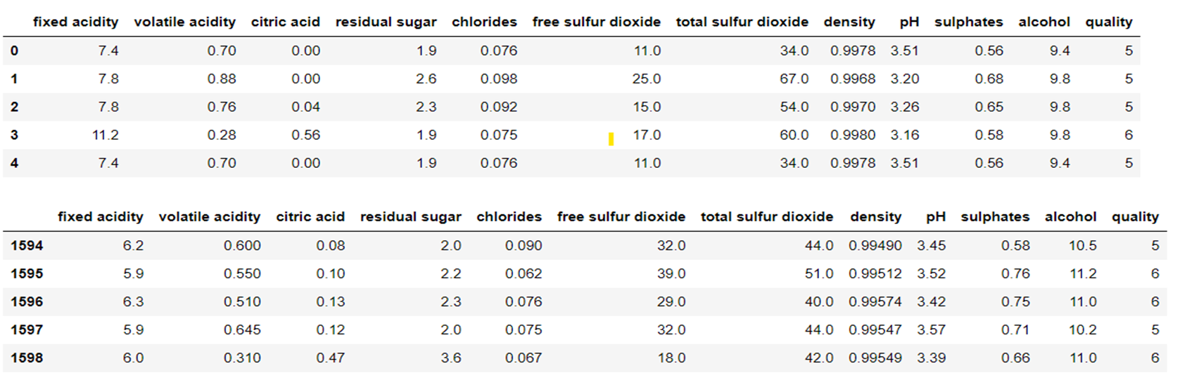
The aim of this project is to predict the quality of wine on a scale of 0–10 given a set of features as inputs. The dataset used is Wine Quality Data set from UCI Machine Learning Repository. Input variables are fixed acidity, volatile acidity, citric acid, residual sugar, chlorides, free sulphur dioxide, total sulphur dioxide, density, pH, sulphates, alcohol. And the output variable is quality (score between 0 and 10). We have quality being one of these values: [3, 4, 5, 6, 7, 8]. The higher the value the better the quality.
Sample Dataset

Slide 4
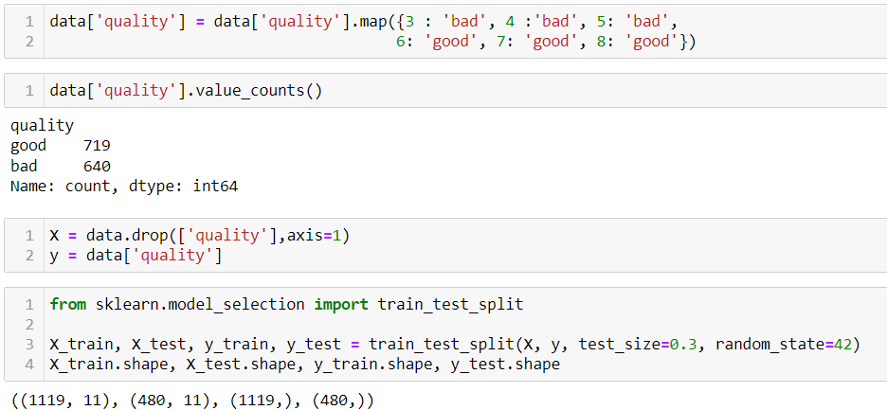
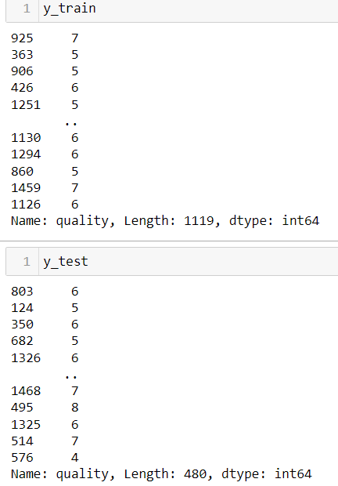
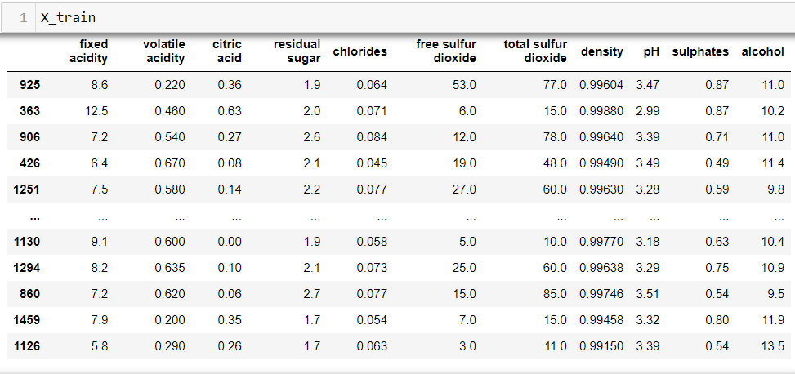
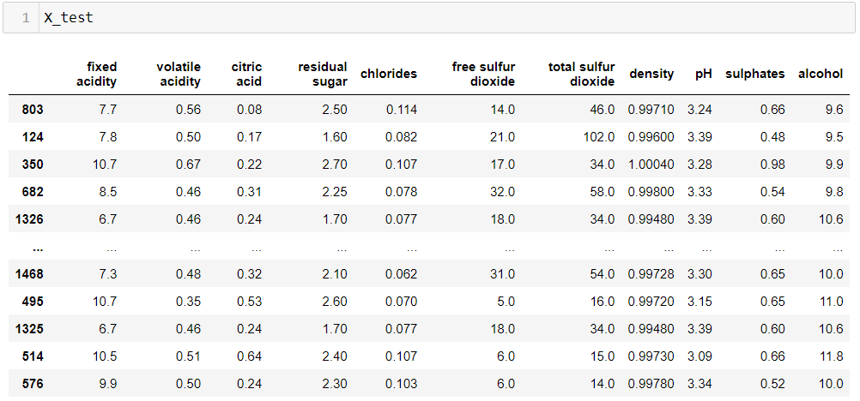
Train Validation Split
Splitting the dataset into a training dataset and testing dataset using train_test_split () method of scikit learn module. 1600 data in the dataset has been divided as 70% of a dataset into training dataset-1120 and 30% of a dataset into testing dataset-480 data.

Slide 5
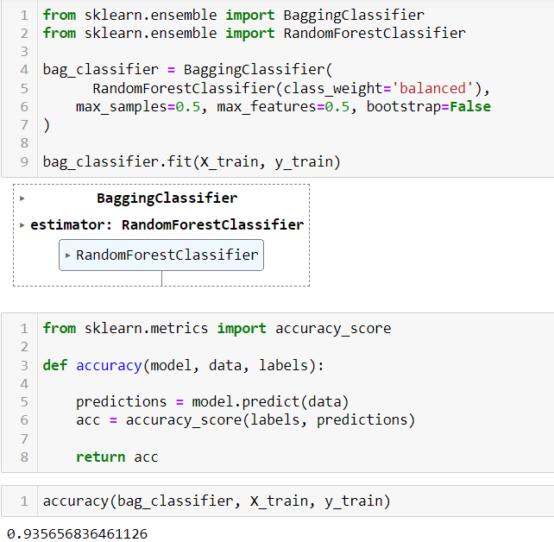
Prediction:
The data has been split into test part for the prediction of test data of size 480 units. From the analysis I have found that the Random Forest Classifier with bagging classifier working well with the accuracy of 93.5% of all the other models that have been tested.

Slide 6
Conclusion:
The results of the studies lead us to believe that the Random Forests Algorithm outperforms other classifiers in classification tasks. The Random Forest Algorithm predicts wine quality with a maximum accuracy of 66.8% percent with using a bagging classifier 93.5%, Logistic Regression with the accuracy of 54.3% and, Decision tree with the accuracy of 57%. Therefore, in the classification algorithms by selecting the appropriate features and balancing the data can improve the performance of the model.

